Slide 1
Shop house
BY:- Group -16 UNDER THE GUIDANCE OF:
Mohd Amaan Khan MR. WASEEM AHMAD
(2000560100068) (CSE Department)
Faiz Mohammad
(2000560100045)
Sahil Khan
(2000560100086)

Slide 2

AGENDA
INTRODUCTION
ER Diagram
RIMARY GOALS
Technology used
First Glimpse
SUMMARY

Slide 3

INTRO
Online shopping is a form of electronic commerce which allows consumers to directly buy goods or services from a seller over the Internet using a web browser or a mobile app. Consumers find a product of interest by visiting the website of the retailer directly or by searching among alternative vendors using a shopping search engine, which displays the same product's availability and pricing at different e-retailers.
.

Slide 4
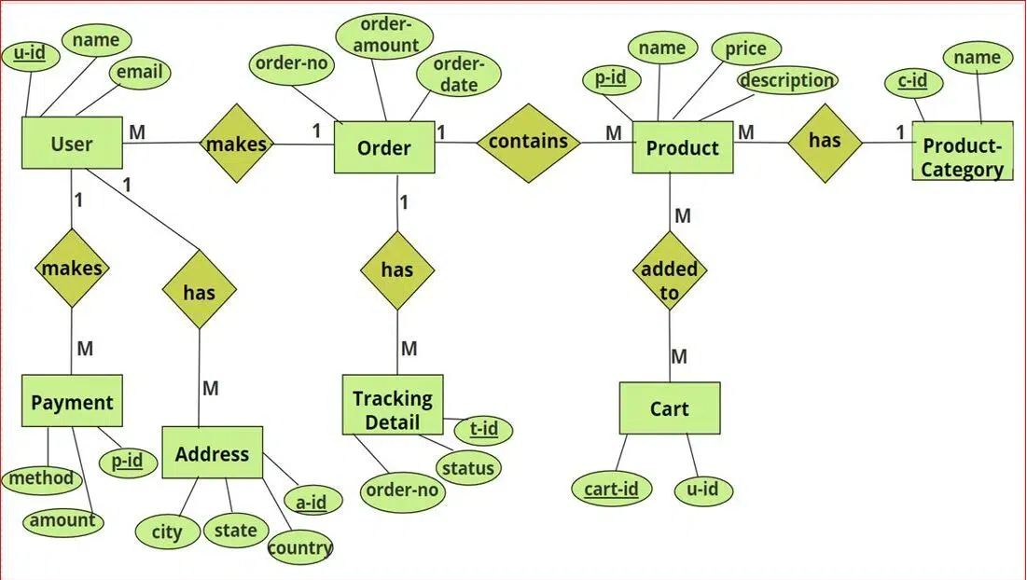
Er Diagram

Slide 5
PRIMARY GOALS
The Primary goal of our SHOP HOUSE project is to provide a safe , efficient, and personalized Experience for customers.
This involves optimizing customer interactions ,
inventory management, and continuous improvement and ensure the highest quality of service.

Slide 6
Technology used
PYTHON
HTML
CSS
BOOTSTRAP
DJANGO

Slide 7
python
Python is a popular programming language. It was created by Guido van Rossum, and released in 1991.
It is used for:
web development (server-side),
software development,
mathematics,
system scripting

Slide 8
html
HTML, or Hypertext Markup Language, is a markup language for the web that defines the structure of web pages.
It is one of the most basic building blocks of every website, so it's crucial to learn if you want to have a career in web development.
In this article, I will walk you through what HTML is about in detail, how it does things on web pages, and we'll also touch on a really cool part of HTML

Slide 9
css
CSS stands for Cascading style sheets. It describes to the user how to display HTML elements on the screen in a proper format. CSS is the language that is used to style HTML documents.
In simple words, cascading style sheets are a language used to simplify the process of making a webpage

Slide 10
bootstrap
Bootstrap is the most popular HTML, CSS and JavaScript framework for developing a responsive and mobile friendly website.
It is absolutely free to download and use.
It is a front-end framework used for easier and faster web development.
It includes HTML and CSS based design templates for typography, forms, buttons, tables, navigation, modals, image carousels and many others.
It can also use JavaScript plug-ins.
It facilitates you to create responsive designs

Slide 11
Django
Django is a Python framework that makes it easier to create web sites using Python.
Django takes care of the difficult stuff so that you can concentrate on building your web applications.
Django emphasizes reusability of components, also referred to as DRY (Don't Repeat Yourself), and comes with ready-to-use features like login system, database connection and CRUD operations (Create Read Update Delete).

Slide 12
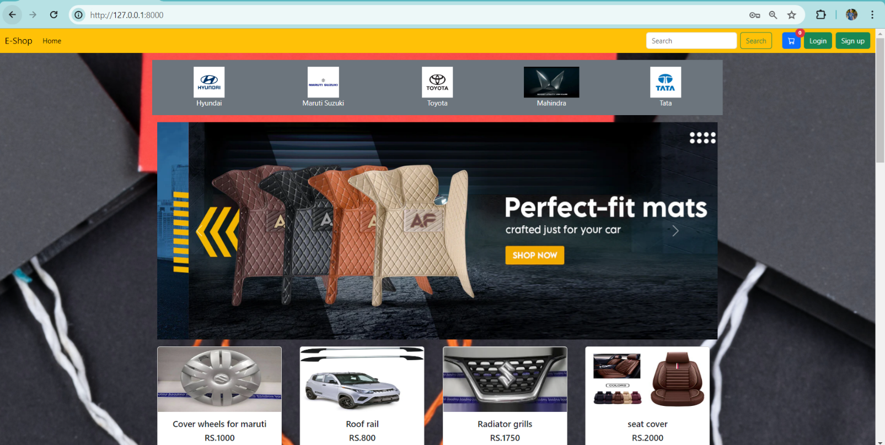
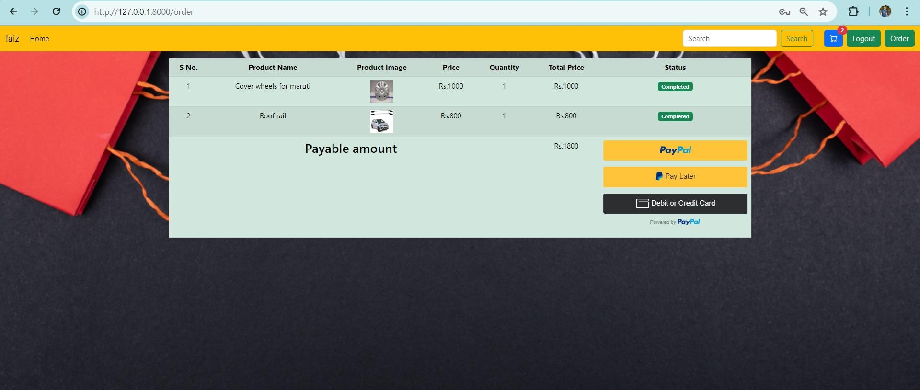
First glimpse of our project. . .

Slide 13
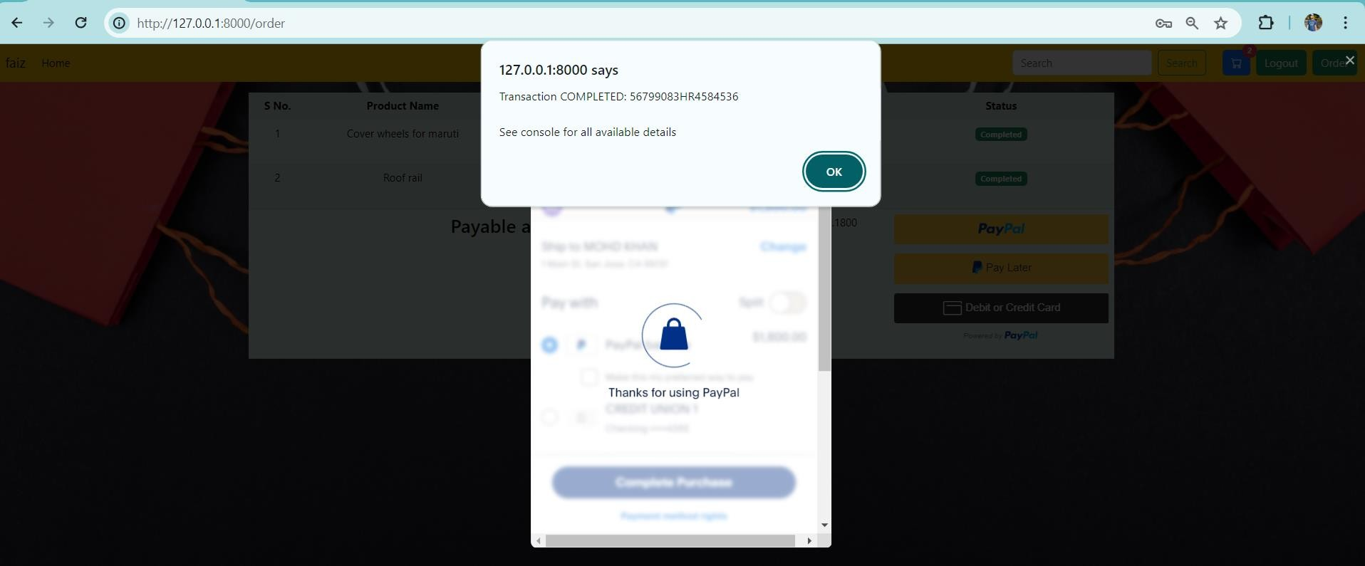
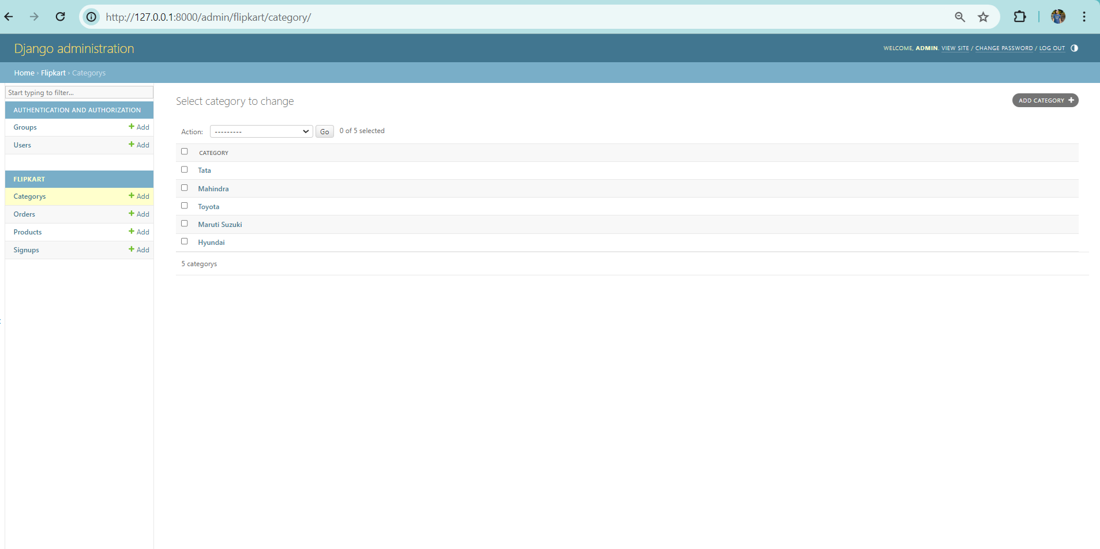

Slide 14

SUMMARY
In conclusion, our e-commerce website project has successfully bridged the gap between technology and the shopping , offering a user-friendly platform for product searches and transactions. We've strived to simplify the e-commerce experience. I'm deeply thankful for your time and attention, and I invite any questions or feedback you may have. This project represents not just an accomplishment but also a starting point for further innovation in this dynamic field. As technology continues to reshape the e-commerce, we can look forward to a future where finding the perfect property is effortlessly accessible. Thank you for being part of this journey.

Slide 15
BUSINESS OPPORTUNITIES ARE LIKE BUSES. THERE'S ALWAYS ANOTHER ONE COMING.
“
”
Richard Branson

Slide 16
THANK YOU

